Slide 1


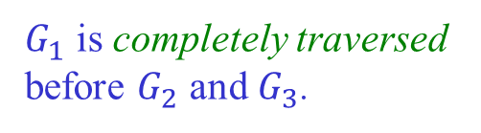


Depth-First Search
Idea: Keep going forward as long as there are unseen nodes
to be visited. Backtrack when stuck.
$G_{1}$ is completely traversed
before $G_{2}$ and $G_{3}$.
$$v$$
$$G_{3}$$
$$G_{1}$$
$$G_{2}$$

Slide 2


Color Map & Predecessor
Just like in BFS:
♦ color($v$) == green: $v$ is undiscovered and unprocessed
♦ color($v$) == red: $v$ has been discovered but not processed
♦ color($v$) == black: $v$ has been discovered and processed
pred($v$): predecessor of $v$ in the search.

Slide 3
The DFS Algorithm
dfs(G):
foreach node v in G
color(v) = green
pred(v) = null
foreach node v in G
if color(v) == green
dfsVisit(G, v, color, pred)
return pred
dfsVisit(G, u, color, pred):
color(u) = red
foreach neighbor v of u
if color(v) == green
pred(v) = u
dfsVisit(G, v, color, pred)
color(u) = black

Slide 4












A DFS Example
time = 1
(time at which a node is visited)
8
9
$$a$$
$$h$$
$$i$$
4
$$c$$
$$d$$
$$e$$
6
7
10
$$j$$
5
$$g$$
$$b$$
$$k$$
$$l$$
$$f$$
11
12
2
3

Slide 5












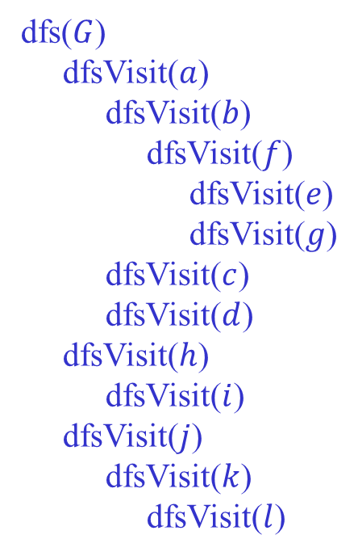
Recursive DFS Calls
1
dfs($G$)
dfsVisit($a$)
dfsVisit($b$)
dfsVisit($f$)
dfsVisit($e$)
dfsVisit($g$)
dfsVisit($c$)
dfsVisit($d$)
dfsVisit($h$)
dfsVisit($i$)
dfsVisit($j$)
dfsVisit($k$)
dfsVisit($l$)
$$a$$
$$c$$
$$d$$
$$e$$
4
6
7
5
$$g$$
2
3
$$b$$
$$f$$
8
9
$$h$$
$$i$$
10
$$j$$
$$k$$
$$l$$
dfsVisit(v) explores every unvisited vertex
reachable from v before it returns.
11
12

Slide 6





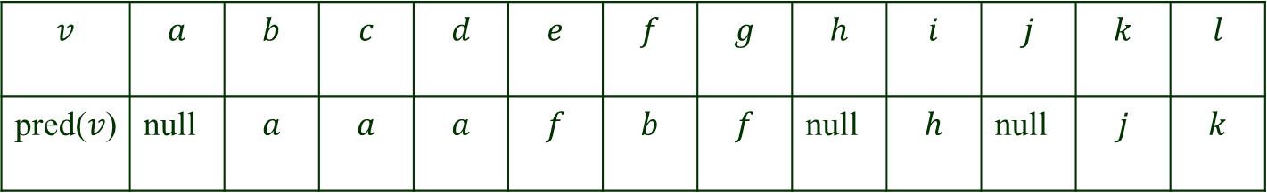
Predecessor Table
$$a$$
$$c$$
$$d$$
$$e$$
$$j$$
$$h$$
$$i$$
$$k$$
$$l$$
$$g$$
$$b$$
$$f$$
$$v$$ | $$a$$ | $$b$$ | $$c$$ | $$d$$ | $$e$$ | $$f$$ | $$g$$ | $$h$$ | $$i$$ | $$j$$ | $$k$$ | $$l$$
pred($v$) | null | $$a$$ | $$a$$ | $$a$$ | $$f$$ | $$b$$ | $$f$$ | null | $$h$$ | null | $$j$$ | $$k$$

Slide 7











Depth-First Search Forest
$$a$$
$$h$$
$$i$$
$$c$$
$$d$$
$$e$$
$$j$$
$$g$$
$$k$$
$$l$$
$$b$$
f
Edges that, during DFS, lead to an unexplored vertex form a depth-first
search forest.
The DFS forest can be constructed from the predecessor table.

Slide 8






DFS on a Directed Graph
$$a$$
$$e$$
$$b$$
$$c$$
$$f$$
$$g$$
$$d$$

Slide 9





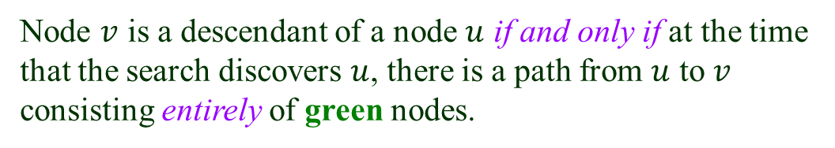


The Green-Path Theorem
♦ color($v$) == green: $v$ is undiscovered and unprocessed
DFS forest of a (directed or undirected) graph $G:$
Node $v$ is a descendant of a node $u$ if and only if at the time
that the search discovers $u$, there is a path from $u$ to $v$
consisting entirely of green nodes.
$$s$$
$$u$$
$v$ will be discovered after $u$
and before DFS backtracks to $u$.
green path
$$v$$
$v$ is in the DFS subtree rooted at $u$.

Slide 10


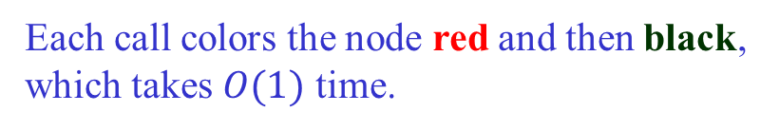

Running Time of DFS
$(|V| + |E|)$ if we use an adjacency list or HashMap/HashSet.
dfsVisit is called exactly once for each node.
$|V|$such calls in total.
Each call colors the node red and then black,
which takes $O(1)$ time.
Each edge is examined $O(1)$ time.
$(|V|^{2})$ if we use an adjacency matrix.

Slide 11












Edge Classification – Undirected Graphs
1. Tree edges are those in the DFS forest.
2. Back edges go from a vertex to one of its ancestors.
$$a$$
$$h$$
$$j$$
$$b$$
$$c$$
$$d$$
$$i$$
$$k$$
$$f$$
$$l$$
$$g$$
$$e$$
This DFS forest consists of three DFS trees.

Slide 12





Edge Classification – Directed Graphs
Besides tree edges and back edges, there are also
3. Forward edges go from a vertex to one of its descendants.
4. Cross edges: all other edges.
$$a$$
$$b$$
$$d$$
$$h$$
$$g$$
$$c$$
$$e$$
$$i$$
If all the edges were undirected, forward and cross edges would be either
tree or back edges.

Slide 13









How to Tell Them Apart?
Tree edges lead to green (new) nodes and form DFS trees.
$$a$$
DFS tree 1
$$b$$
$$d$$
$$h$$
DFS tree 2
$$g$$
$$c$$
$$e$$
$$i$$
Add every other separately to the DFS forest.
Back edges connect nodes in the same DFS tree.
♦ back edge: descendent $→$ ancestor

Slide 14









Forward Edge
Forward edges also connect nodes in the same DFS tree.
♦ forward edge: ancestor $→$ descendent
$$a$$
$$b$$
$$d$$
$$h$$
$$g$$
$$c$$
$$e$$
$$i$$

Slide 15
















Cross Edge
Each cross edge is one of two cases:
♦ Its two vertices are in the same DFS tree but not related.
$$a$$
$$b$$
$$d$$
$$h$$
$$g$$
$$c$$
$$e$$
$$i$$
♦ They are in different DSF trees.
$$a$$
$$b$$
$$d$$
$$h$$
$$g$$
$$c$$
$$e$$
$$i$$

